Slide 1
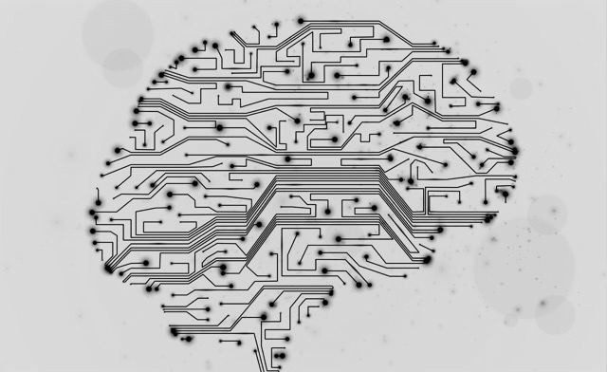
Deep Learning for Music Generation
Using Recurrent Neural Networks - Long Short Term Memory: A comparative analysis
Presented by:
Chetan Chawla

Slide 2

Music Generation
Music is rightfully defined as the god’s own language.
Piano is a very versatile instrument.

Slide 3
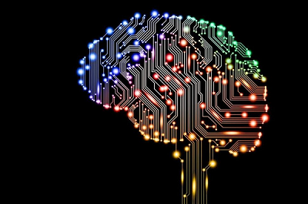
History of Music Generation
Musikalisches Würfelspiel (Musical Dice game)
Leonard Bernstein’s Lecture on music and language in 1973

Slide 4
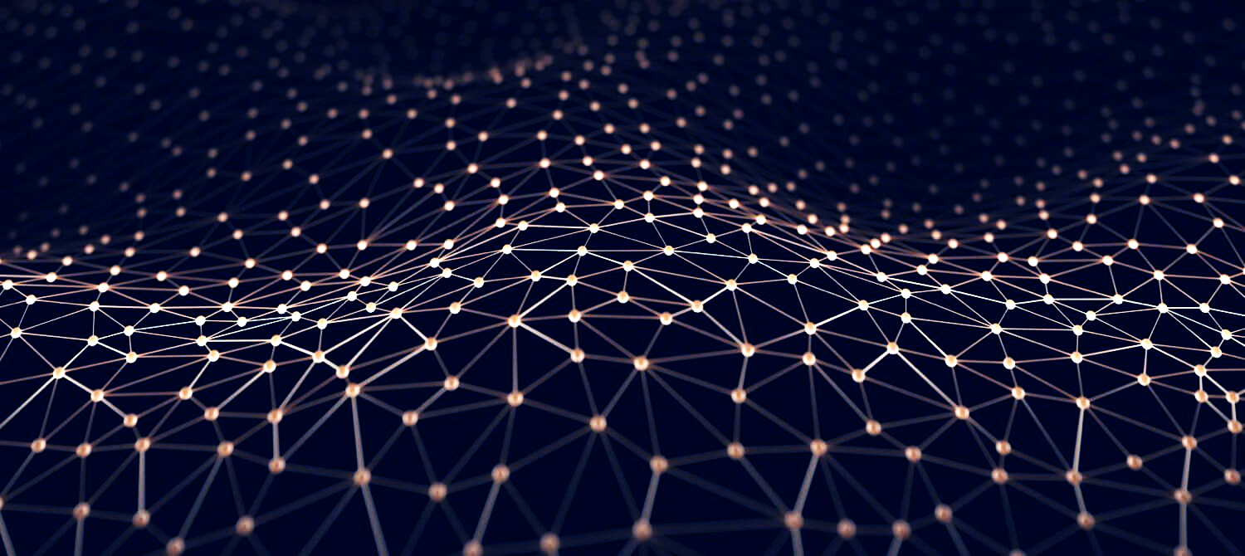
Conventional Methods
Mathematical models
Knowledge based systems
Musical Grammars
Evolutionary Methods
Systems which Learn
Make sure to explgfgfain why it is a real problem. jnnjnj

Slide 5
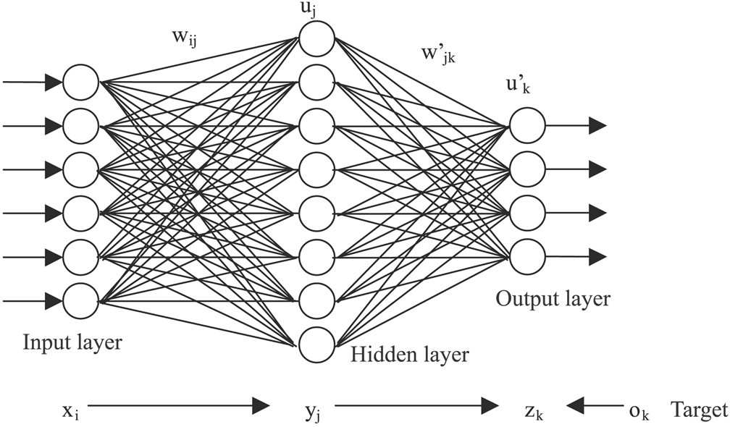
Generation of Music using Neural Networks
Character based sequential generative model
Recurrent Neural Networks
Long Short Term Memory Model
Gated Recurrent Units

Slide 6
Related Work

Slide 7
Chen et al (2001) – earliest papers – Bela Bartok’s Musical Grammar - constrained generation
Eck et al (2002)- used two parallel LSTMs
Latest methods use RTRBM (Recurrent Temporal Restricted Boltzmann Machine) for polyphonic unconstrained generation of music.

Slide 8
The Architecture

Slide 9
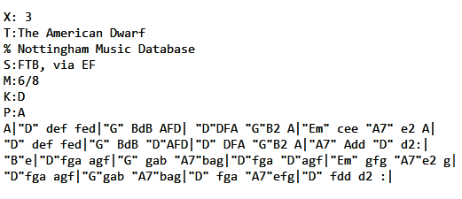
Data
ABC Notations of Music
Nottingham Database – 340 songs with 125,000 characters
4 times larger the data
1

Slide 10
Model

Slide 11
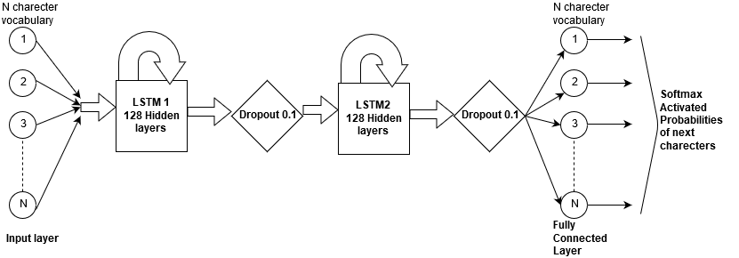

Slide 12
Layer (type) Output Shape Parameters ================================================================= lstm_1 (LSTM) (None, None, 128) 113664 _________________________________________________________________ dropout_1 (Dropout) (None, None, 128) 0 _________________________________________________________________ lstm_2 (LSTM) (None, 128) 131584 _________________________________________________________________ dropout_2 (Dropout) (None, 128) 0 _________________________________________________________________ dense_1 (Dense) (None, 93) 11997 _________________________________________________________________ activation_1 (Activation) (None, 93) 0 ================================================================= Total parameters: 257,245 Trainable parameters: 257,245 Non-trainable parameters: 0

Slide 13
Working

Slide 14
Each character from the ABC notation of a song is first converted into a indexes.
These indices are then converted into one hot vectors
One character is fed from the notation to the LSTM network at time T
The network generates output predicted characters at T+1 time which are used for generation as well as training

Slide 15
Results
The best statistical results were the training accuracies of 99.70 % and 54% validation accuracies with Categorical Cross Entropy Loss mean squared error minimization.
Best musical results were found on the second database which was less complex, using 128 hidden layers, 2-layer stacked LSTM model, ironically, with the least training and validation accuracy 97.88% and 42.9%

Slide 16
Questions?

Slide 17
References
Andrej Karpathy, “The Unreasonable effectiveness of Recurrent Neural Networks”, http://karpathy.github.io/2015/05/21/rnn-effectiveness/ May 2015
T Mikolov, M Karafiát, L Burget, J Cerno, “Recurrent neural network based language model”, Interspeech, 2010 - fit.vutbr.cz
Chun-Chi J. Chen and Risto Miikkulainen, “Creating melodies with evolving recurrent neural networks”, Proceedings of the 2001 International Joint Conference on Neural Networks, 2001.
Nicolas Boulanger-Lewandowski, Yoshua Bengio, and Pascal Vincent, “Modeling temporal dependencies in high-dimensional sequences: Application to polyphonic music generation and transcription”, Proceedings of the 29th International Conference on Machine Learning, (29), 2012.
Douglas Eck and Jurgen Schmidhuber, “A ﬁrst look at music composition using lstm recurrent neural networks”, Technical Report No. IDSIA-07-02, 2002.
A Huang, R Wu, “Deep learning for music”, arXiv preprintarXiv:1606.04930,2016
The ABC Music project - The Nottingham Music Database : http://abc.sourceforge.net/NMD/jigs.txt
https://github.com/saketsharmabmb/Music-Generation-Character-level-RNN/tree/master/data
http://abcnotation.com/software
https://docs.google.com/document/d/1bgggdsoTreNfru06Wz3tIgXXh7_edNPt1-o-fE_WSuc/edit?usp=sharing

Slide 18
Thank You

